Slide 1
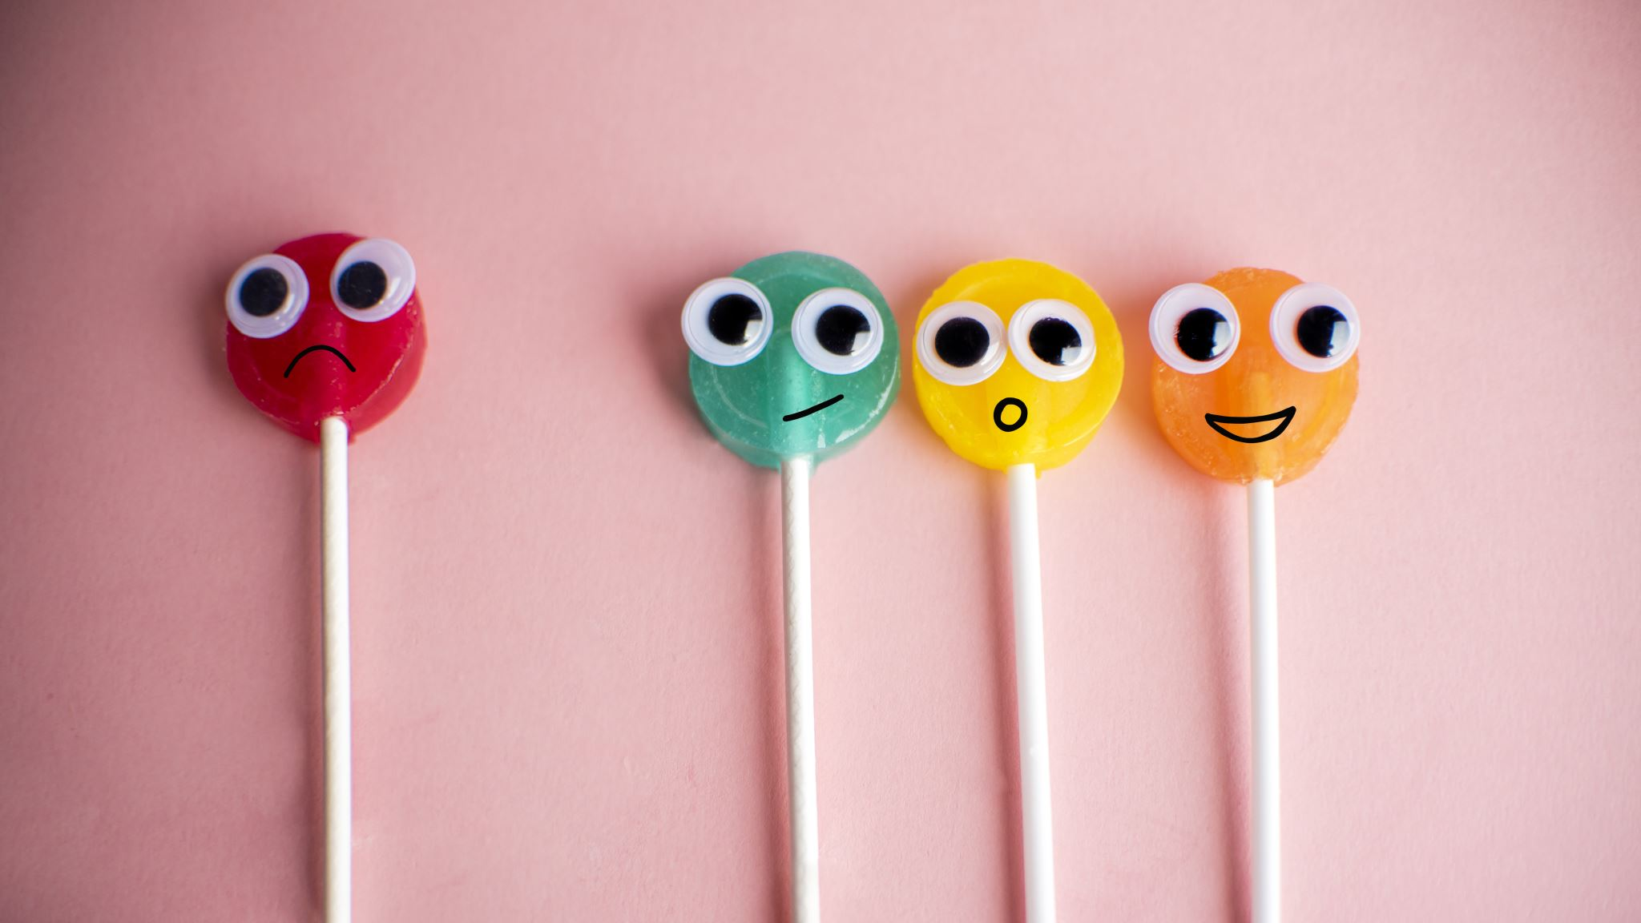
Interactive Story Generation

Slide 2
Flow of Talk
Problem Statement
Motivation
Literature Review
Novelty
Database Used
Code
Methodology
Evaluation

Slide 3

Problem Statement
Storytelling [1] has been one of the most essential parts of human culture for many years. People tell stories to others to share their experiences, beliefs, and values via paintings, carvings, movies, podcasts, etc. Technological advancements and increased Artificial Intelligence have expanded our ability to tell stories. AI-based storytelling has become popular, but producing consistent, coherent, and engaging narratives takes a lot of work. This encompasses issues such as maintaining logical plot progression, developing well-rounded characters, and ensuring that the story’s pacing remains appropriate. The AI may struggle with generating stories that flow naturally and captivate the audience, leading to disjointed or unsatisfying narrative experiences. Additionally, balancing creativity with coherence presents a complex problem, as the AI must innovate within established storytelling frameworks while still adhering to logical constraints.
This project aims to build a platform for interactive story generation by finetuning Large Language Models, such as GPT-2 models based on different themes. It also focuses on developing stories, ensuring consistency, coherency, and engaging narratives.

Slide 4

Motivation
With this project, we want to present the utility of Large Language Models for generating narratives. The idea behind this project is that engaging storytelling is fundamental to capturing and retaining users’ attention, fostering immersion, and eliciting emotional responses. Without compelling narratives, users are less likely to interact with the AI generator, leading to diminished satisfaction and decreased utility of the tool. Moreover, it is crucial to solve this issue since it is necessary to expand the potential of Generative AI in several fields, such as therapy, education, and entertainment. It also has the potential to increase the explainability of the AI models, especially Large Language Models, to help researchers enhance the AI models for various applications in future

Slide 5

Literature Survey
Fan et al. [3] have developed the dataset for story generation that is Writing Prompts, which has approximately 300K stores along with its prompts and trained fusion of Conv Seq2seq + self-attention-based model and achieved the perplexity of 36.08 and 36.56 on validation and testing set respectively and performed well on human evaluation test.
Khan et al. [4] have developed a keyword-based story generation model by finetuning the GPT 2 model on the private dataset they created. They achieved the BLEU score of about 0.704, averaging over ten genres
Yao et al. [5] proposed a framework for generating the stories called Play-and-Write, which plans the storyline and generates the stories. It works in two static and dynamic schemas, which have performed better than the baselines in objective and subjective evaluation.

Slide 6
Novelty
The novelty is introduced to the dataset. Unlike other story generation datasets, this dataset is collected from various websites, taking care of repeating the stories in the corpus and not including inappropriate stories as seen in other corpora.

Slide 7

DataSet
We have scrapped about 356 stories from websites like Medium, Reddit, Project Gutenberg, etc., based on six themes: adventure, horror, humour, mystery, romantic and sci-fi.
However, the horror stories have been taken directly from the dataset used during baseline results. Some stories that exceed the word limit of 500 words are summarised using chat GPT 3.5. Based on the available computing resources, we worked with 100 adventure stories, 100 sci-fi stories and 100 horror stories.
For each theme, nine stories are used for training, three for validation, and three for model testing. Figures 1, 2, and 3 show the maximum token length of the stories of each split per theme.

Slide 8
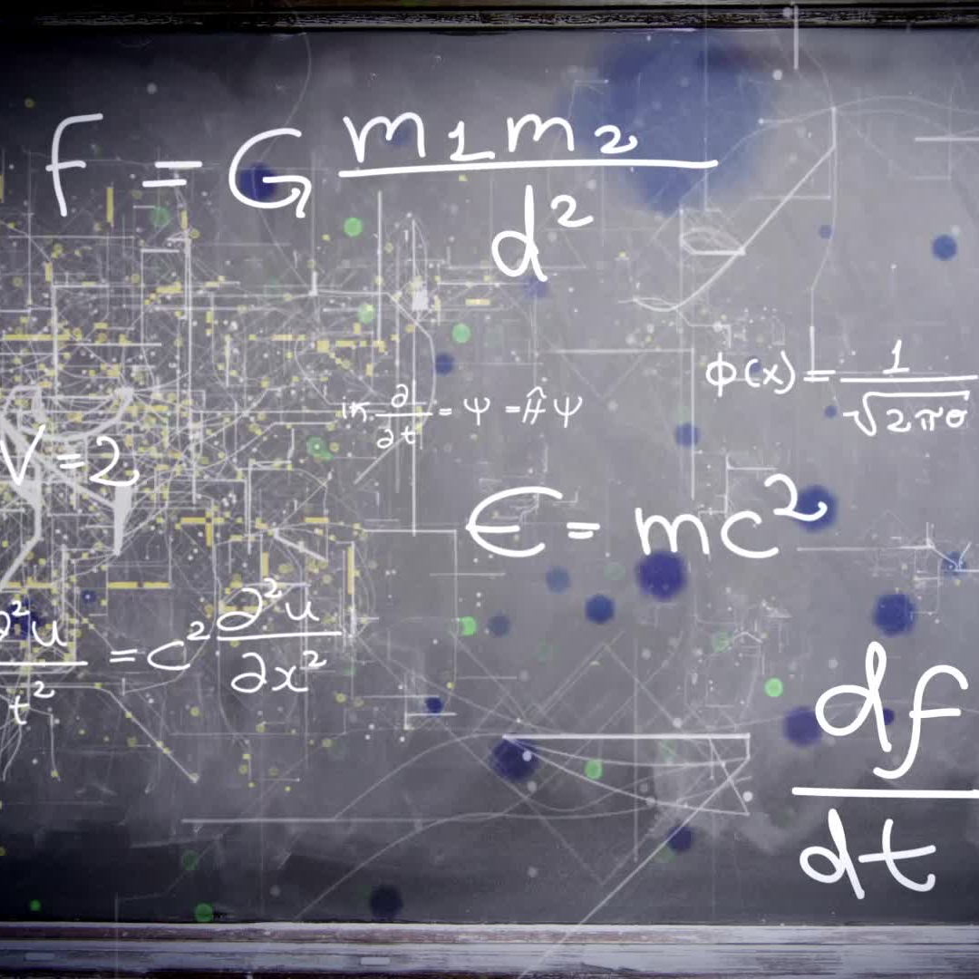
Methodology
The prompts are created by taking the story's beginning, and each story and its corresponding prompt is saved in the .csv files, as shown in Figure 4.
Then, the prompts and the stories are combined in a conversational format, as suggested by [11].
The Gemma2B Instruct model is loaded from the hugging face library, and then it is quantised using LoRA and QLoRA so that it will not occupy too much space on the GPU, as suggested by [11].
Then, the model is finetuned for each theme to 4 epochs, with a learning rate of 0.0001 using a paged-adamw 8-bit optimiser, and the loss curves are plotted. Here, we have used 75 data samples for training, 10 for validation and 15 for testing.
The model is merged back to the original precision value for evaluation purposes, as suggested by [11].

Slide 9
Methodology Contd…
Generating the prompts of the stories in the form of the story's title using ChatGPT 3.5 and format it in the conversational format suggested by [12] as shown in figure 5, and saving it into .jsonl format.
Loading the GPT 3.5 model using the OpenAI API key and finetuning it for each theme for 46 epochs and plotting its loss curves and further evaluation is performed. Here, we have used 9 data samples for training, 3 for validation and 3 for testing.

Slide 10
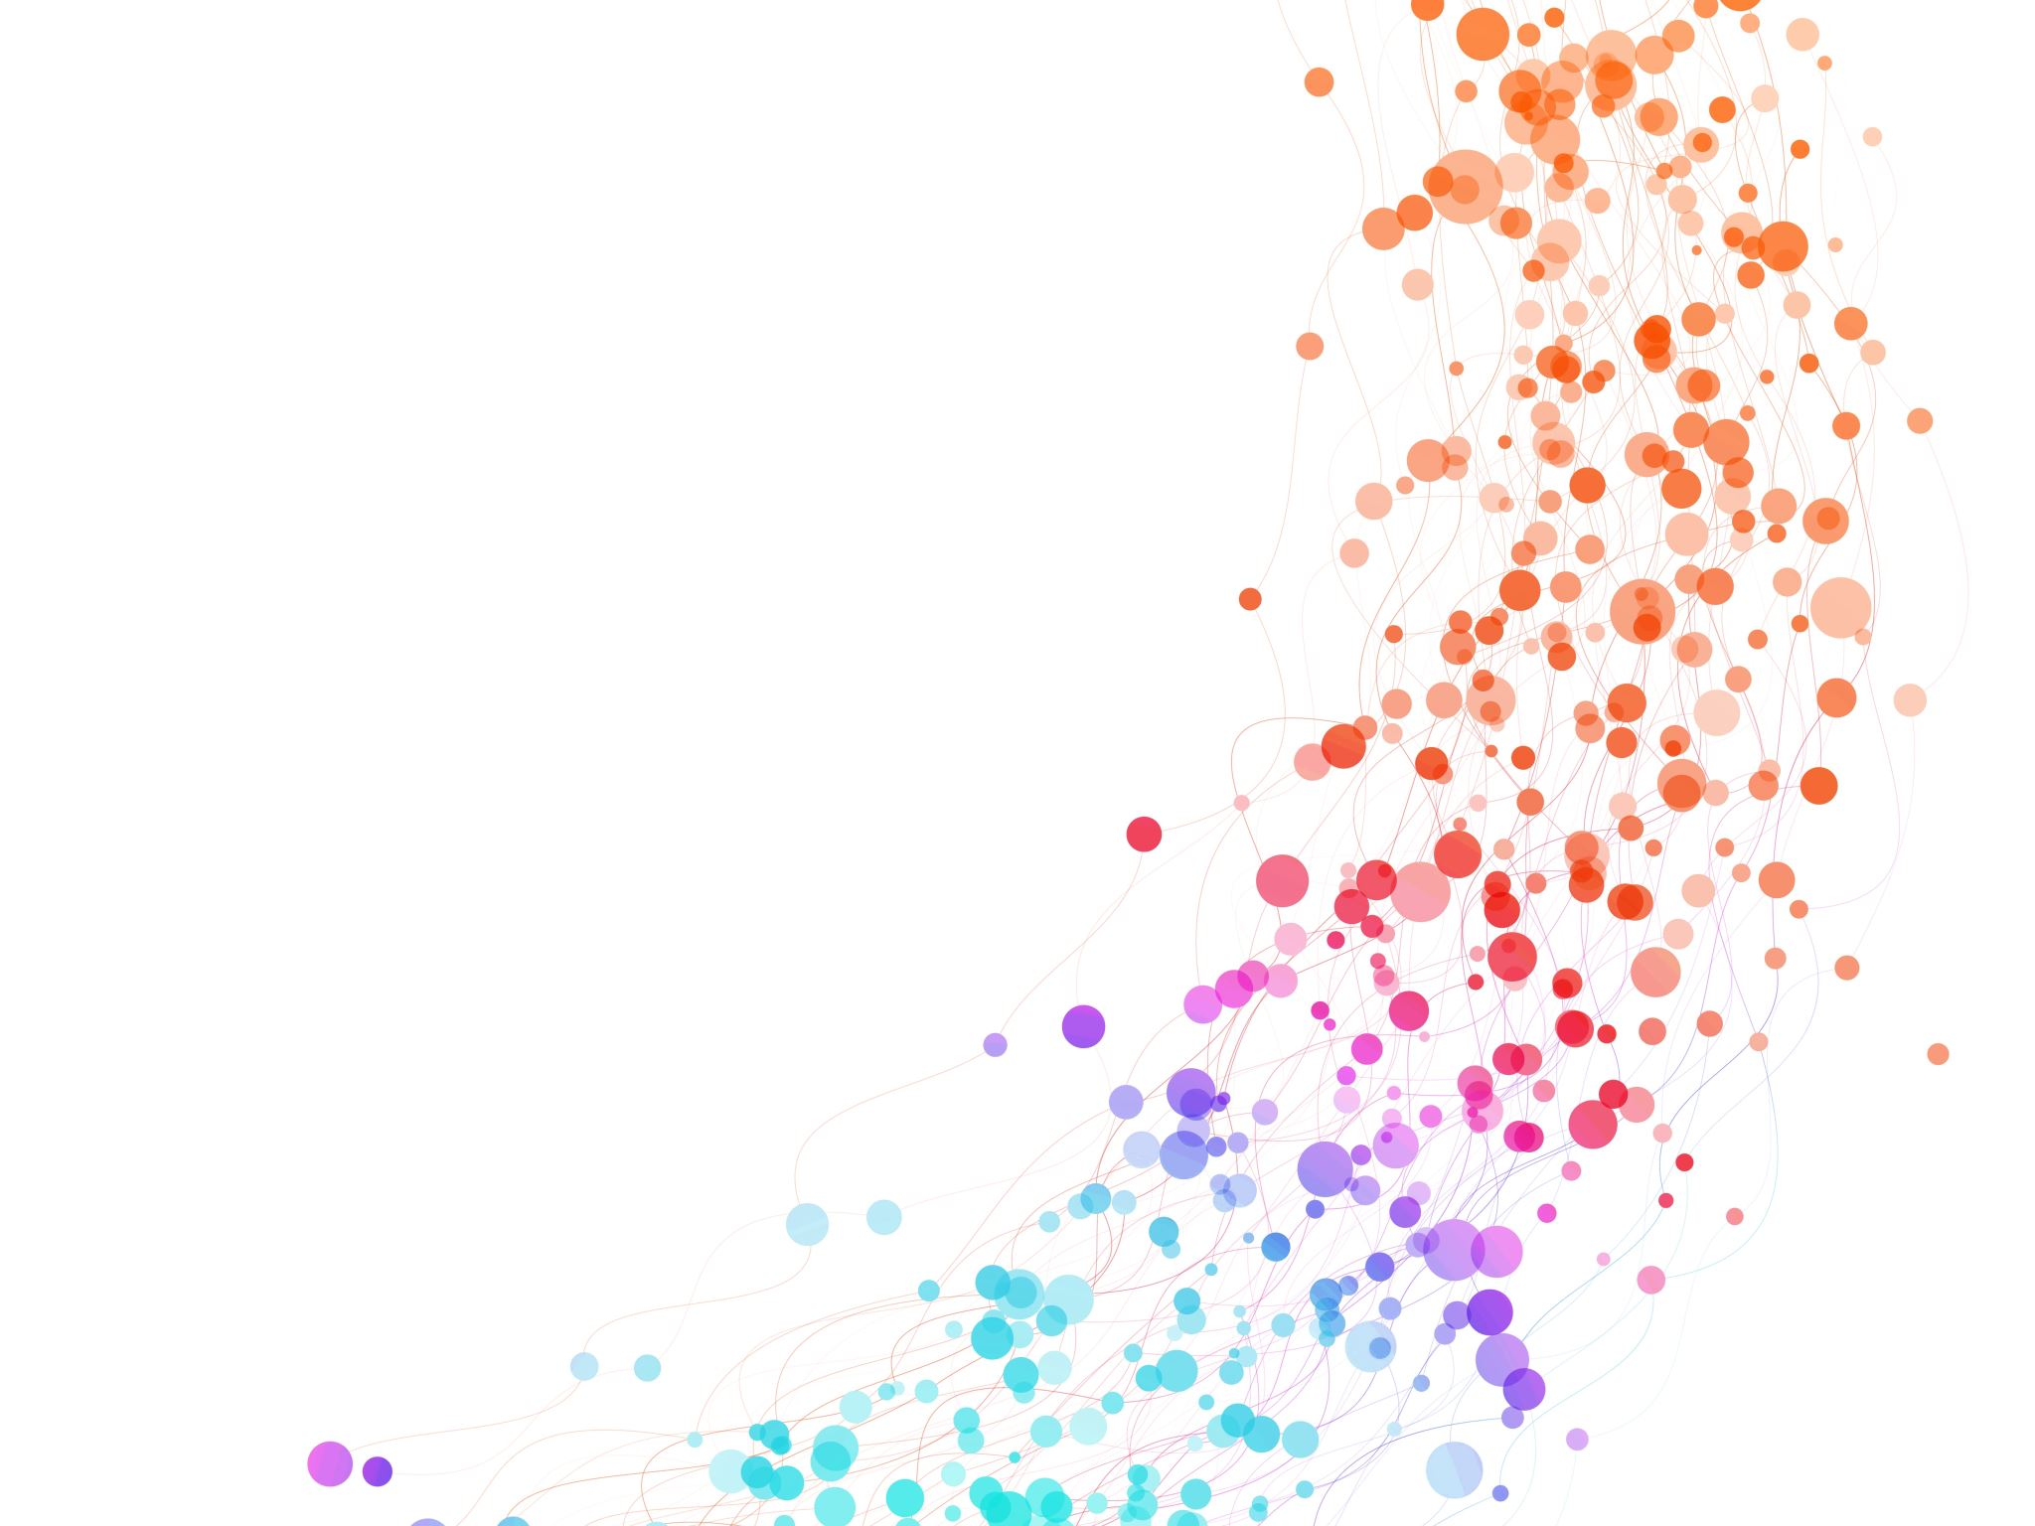
Code
https://github.com/shaina-12/Interactive-Story-Generation.git

Slide 11

Results

Slide 12

Gemma 2B Instruct

Slide 13
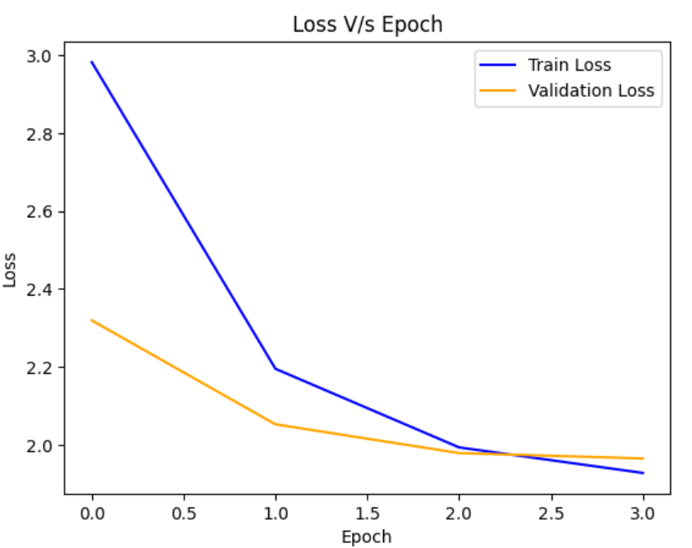
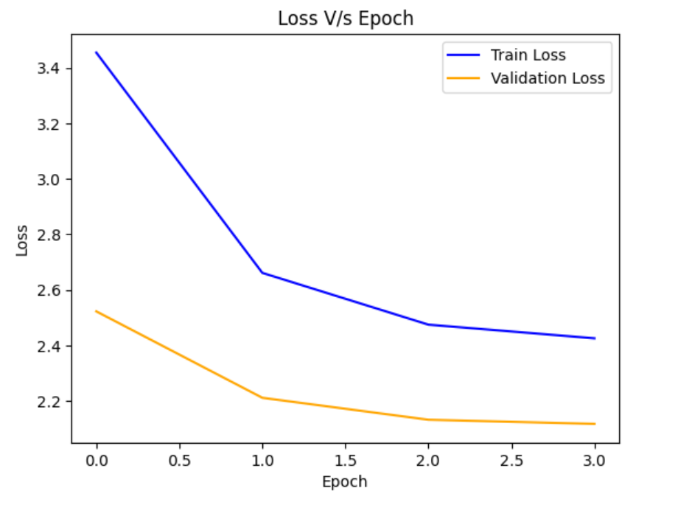
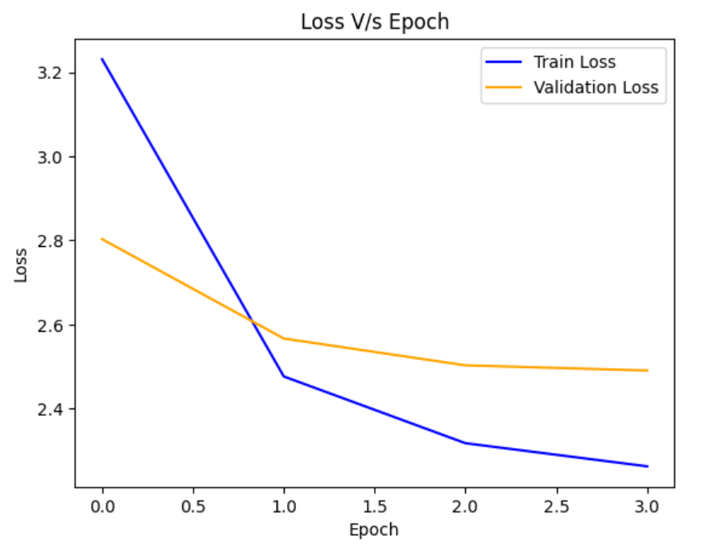
Horror
Adventure
Scifi

Slide 14

Theme | BLEU 1 Score | BLEU 2 Score | BLEU 3 Score | BLEU 4 Score | Mean Perplexity
Adventure | 0.31716247139588094 | 0.17325961579064542 | 0.10919435932358887 | 0.08116519561927048 | 23.833895842234295
Horror | 0.3097818019890159 | 0.15963983213519858 | 0.09817129544520443 | 0.07301270232036362 | 30.47944227854411
Scifi | 0.3482644628099173 | 0.1871588158681989 | 0.12080611134435604 | 0.0924673182941002 | 38.437459055582686

Slide 15

GPT 3.5 Turbo Model

Slide 16
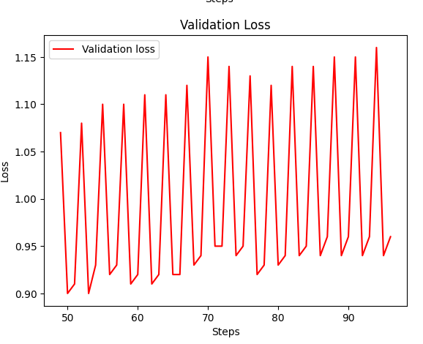
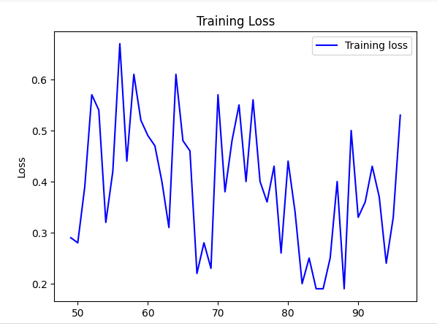
Adventure Theme

Slide 17
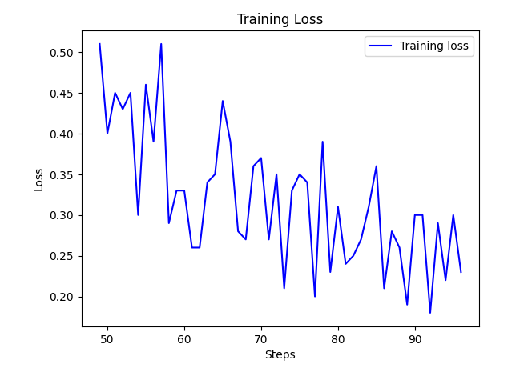
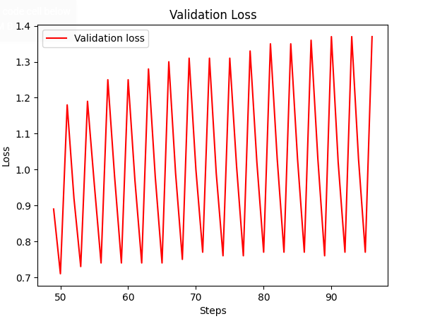
Scifi Theme

Slide 18
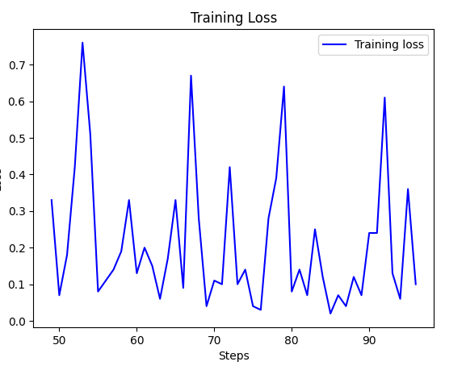
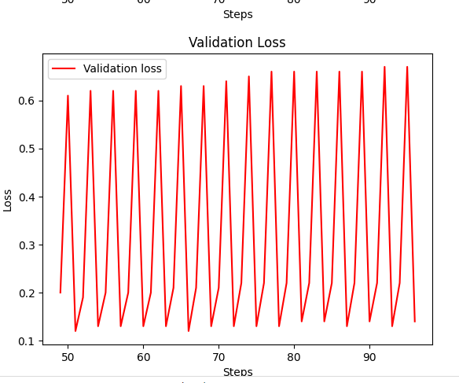
Horror Theme

Slide 19
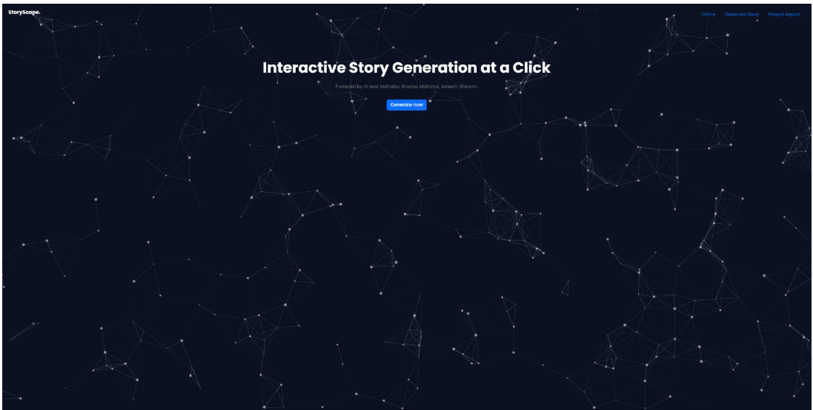
Website

Slide 20
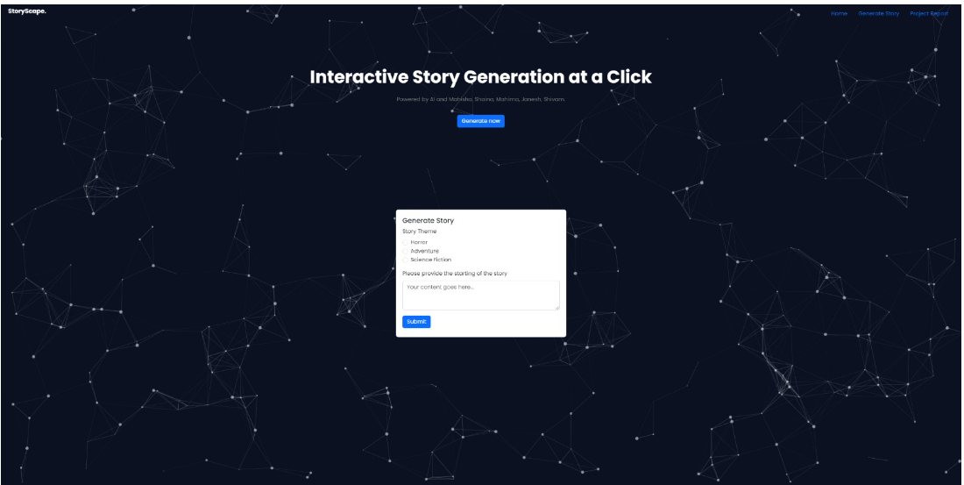

Slide 21
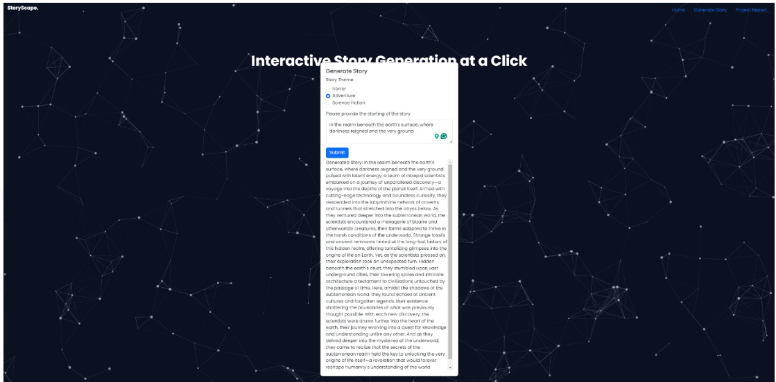

Slide 22
Thank You

